Slide 1


Investment Prediction
Brett Sutow
DSC 630
Final Project

Slide 2
Key Points
Investment Goal
Company Investment Analysis
Utilization of the LSTM Model
Results
Challenges
Expansion of Model

Slide 3
Investments Goal
The goal to create a prediction model for stocks
This will allow us to gain a better understanding for investment purposes
Model should be able to predict future stock prices
Creates accurate investing decisions

Slide 4
Stock Choice
As an investing company we look for an organization that can provide long-term growth
The Walt Disney Company was chosen based off its strong history
The goal is to accurately predict the future prices to get a better entry point for purchase

Slide 5
The Walt Disney Company
We want to better understand future stock prices
Allows us to analyze based off past 60 days data
Utilizes prediction LSTM model to track and create future predictions
Creates better investment decision making for this stock

Slide 6
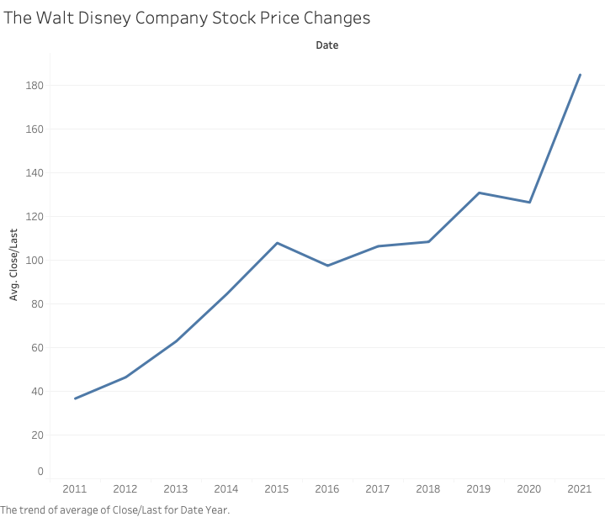
Disney Stock Price
Graph depicts stock changes since 2011
Shows that the company has had significant growth
Great investment potential

Slide 7
LSTM Model
Long Short-Term Memory Model holds the past information
Utilizes time-series data from past 60 days
Which in turn predicts the future price of the next day based off previous
We iterated the model predict the next 20 days

Slide 8
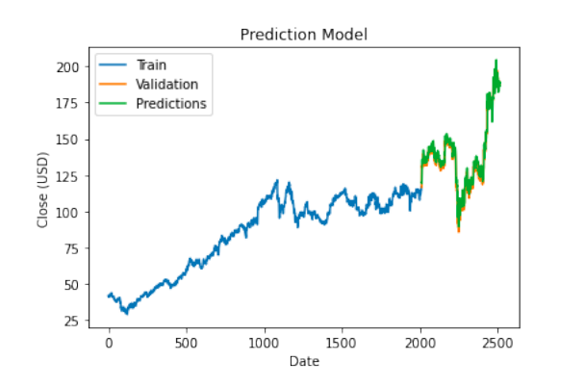
Train, Validation, Prediction
This is working the model through current pricing
Trains the model to properly predict future prices
Data shown on days basis

Slide 9
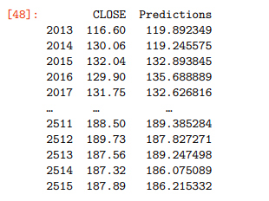
Train, Validation, Prediction
Shows breakdown of training model
Gives understanding of predictions against the actual CLOSE
This was real-time training model

Slide 10
Predictions
The following graph shows the price changes with 20 iterations
This tracks the prediction price over 20 days
We then are comparing this to what we are seeing

Slide 11
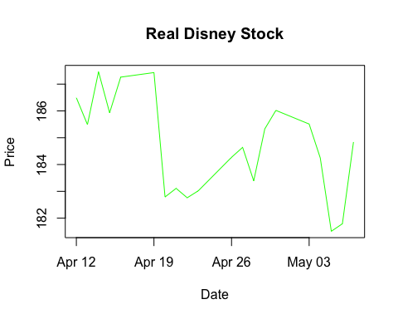
The Walt Disney Company-Real

Slide 12
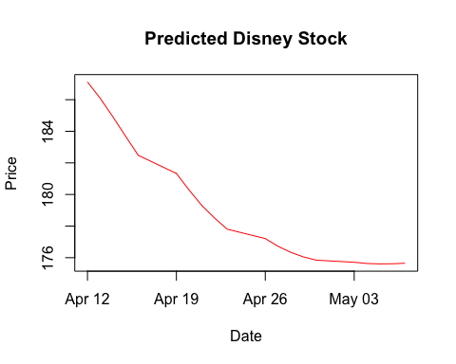
The Walt Disney Company-Prediction

Slide 13
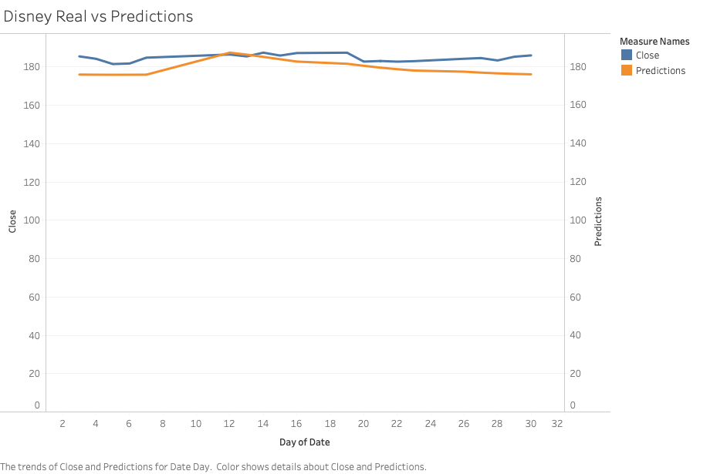
Comparison

Slide 14
Results
The model worked in the prediction phases
Our model could not accurately predict price changes
This is due to all the outside factors in the market

Slide 15
Challenges
Model accuracy due to outside factors
Though LSTM is the best model for stocks, it can be off
Time-series data creates challenging aspects for data prediction
Stock prices are extremely volatile

Slide 16
Outside Factors
The following are outside factors that are unpredictable for stock price changes
Earnings Reports
Press Release
Good/Bad news coverage
Overall market
Political decisions

Slide 17
Why Test?
Need to understand price fluctuations
Testing allows us to mitigate risk of actual investment
Avoidance of loss of investment early on

Slide 18
Expansion of Model
The stock model will be expanded further(more iterations)
As more stock price data comes out updates will continue
Compare future stock predictions with actual prices
Build out more companies in analysis

Slide 19
Final Disclaimer
Due to market uncertainty and previously discussed economic factors, the LSTM model may or may not work overall
The market is control by so many different factors that individual stocks are difficult to predict
We are interested in expanding this model to mutual funds and index funds to see how they move

Slide 20

Questions
Please let me know if you have any questions!

Slide 21
References
Chen, J. (2020, November 27). Blue-Chip Stock Definition. Investopedia. https://www.investopedia.com/terms/b/bluechipstock.asp
Computer Science. (2019, December 22). Stock Price Prediction Using Python & Machine Learning. YouTube. https://www.youtube.com/watch?v=QIUxPv5PJOY
Ganegedara, T. (2021). Attention Required! | Cloudflare. Datacamp. https://www.datacamp.com/community/tutorials/lstm-python-stock-market
Langager, C. (2021, May 11). What Causes a Significant Move in the Stock Market? Investopedia. https://www.investopedia.com/ask/answers/06/stockmarketmove.asp
Nasdaq. (n.d.). Daily Stock Market Overview, Data Updates, Reports & News. https://www.nasdaq.com/
Team, D. (2021, March 14). Stock Price Prediction – Machine Learning Project in Python. DataFlair. https://data-flair.training/blogs/stock-price-prediction-machine-learning-project-in-python/
Using a Keras Long Short-Term Memory (LSTM) Model to Predict Stock Prices. (n.d.). KDnuggets. https://www.kdnuggets.com/2018/11/keras-long-short-term-memory-lstm-model-predict-stock-prices.html#:%7E:text=(%2018%3An45%20)-,Using%20a%20Keras%20Long%20Short%2DTerm%20Memory%20(LSTM),Model%20to%20Predict%20Stock%20Prices&text=LSTMs%20are%20very%20powerful%20in,in%20predicting%20its%20future%20price.

